Slide 1


Social Buzz Data Analysis
Notes:
Welcome everyone this is my presentation for the data that I have analyzed for Social Buzz

Slide 2


Today's agenda
Project recap
Problem
The Analytics team
Process
Insights
Summary
Notes:
Today’s agenda is
1 – About the background info of the company and company’s goals
2 – What problem is faced by Social Buzz
3 – Intro to our team
Process
Explanation of my insights
Summary

Slide 3

Project Recap
Social Buzz is a fast growing technology unicorn that need to adept quickly to it’s global scale
Accenture has begun a 3 month POC focusing on these tasks:
An audit of Social Buzz’s big data practice
Recommendations for a successful IPO
Analysis to find Social Buzz’s top 5 most popular categories of content

Slide 4

Problem
Over 100K posts per day
36.5 Million pieces of content per year!
But how to capitalize on it when there is so much?
Analysis to find Social Buzz’s top 5 most popular categories of content

Slide 5



Andrew Fleming
Chief Technical Architect
The Analytics team
Marcus Romptom
Senior Principle
Andrew Fleming
Chief Technology Architect

Slide 6
Process
1
Data Understanding
2
Data Cleaning
3
Data Modelling
4
Data Analysis
5
Uncover Insights
Notes:
Data modeling is the process of creating a visual representation of either a whole information system or parts of it to communicate connections between data points and structures. The goal is to illustrate the types of data used and stored within the system, the relationships among these data types, the ways the data can be grouped and organized and its formats and attributes.
Relationship

Slide 7

Insights
Animals
Most Popular Category
January
Month with most posts
Photos
Month popular format for content

Slide 8
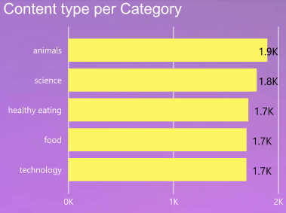
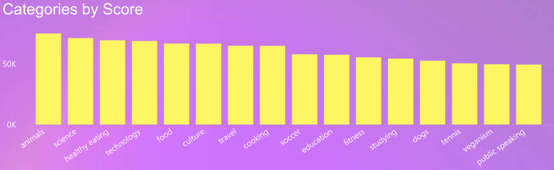
By taking a look at data according to Category we can see that,
Animals is the top field in both the graphs.
The score for animals is the highest
Hence the type of content frequently posted is animals

Slide 9
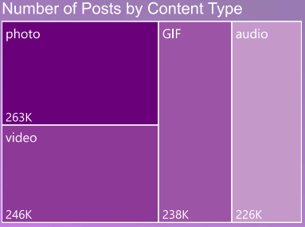
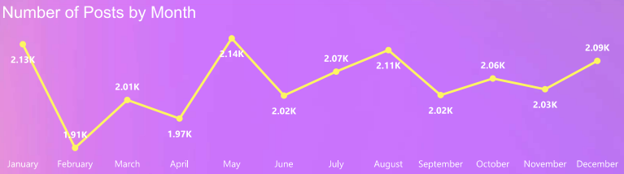
The most popular format of content is photos
Followed by video.
These two type of content are the easiest to consume
Hence, these are the most posted type of format
Here we can see the trend of posts separated by month.

Slide 10

Animals and science are two of the most popular content categories, through this it seems people enjoy nature and information related to the field of science.
Photos are the most consumed piece of content as photos generally do not require much attention of the user as compared to audio.
With the maximum number of posts being around May and January it suggests that the use of Social Buzz is during Summer and Winter vacation.
Summary

Slide 11
Thank you!
ANY QUESTIONS?

